Slide 1
2. Handling Form Submission
Roy Chancellor

Slide 2
Overview
Simple web service that creates a form and validates the length of the Name is between 2 and 30 characters and the Age is greater or equal 18
Uses methods mapped to HTTP GET and POST requests
Download project from https://github.com/roychancellor/SpringDemos.git
Instructions for running are in Application.java
Once server is running, navigate to http://localhost:8080/ to see the form, enter a name and an age, then click Submit or Reset. Clicking Submit will show the form data; clicking Reset will reset the form to default (not quite working properly).
Error messages will show if the form data does not meet the requirement

Slide 3
Project Structure
Application.java: contains main() which Spring finds and runs the SpringApplication.run method
WebController.java: receives and responds to HTTP GET and POST requests
PersonForm.java: a POJO with two data fields and two getters/setters and the validation constraints on the fields
pom.xml: contains all of the Maven dependencies
Spring deploys the application in its own Tomcat server
Comments in the .java files explain how everything works

Slide 4
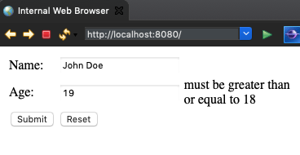
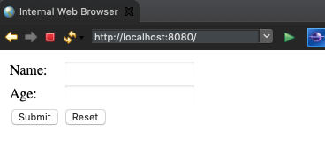
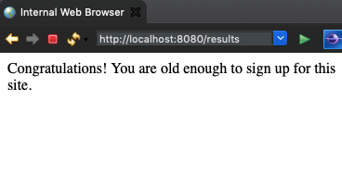
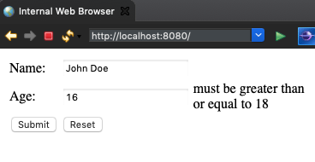
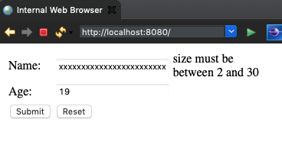
Screen Shots:

